Slide 1

AI-Powered Space Mission Simulation
Unlocking the next frontier of space exploration through intelligent simulation and autonomous systems.

Slide 2
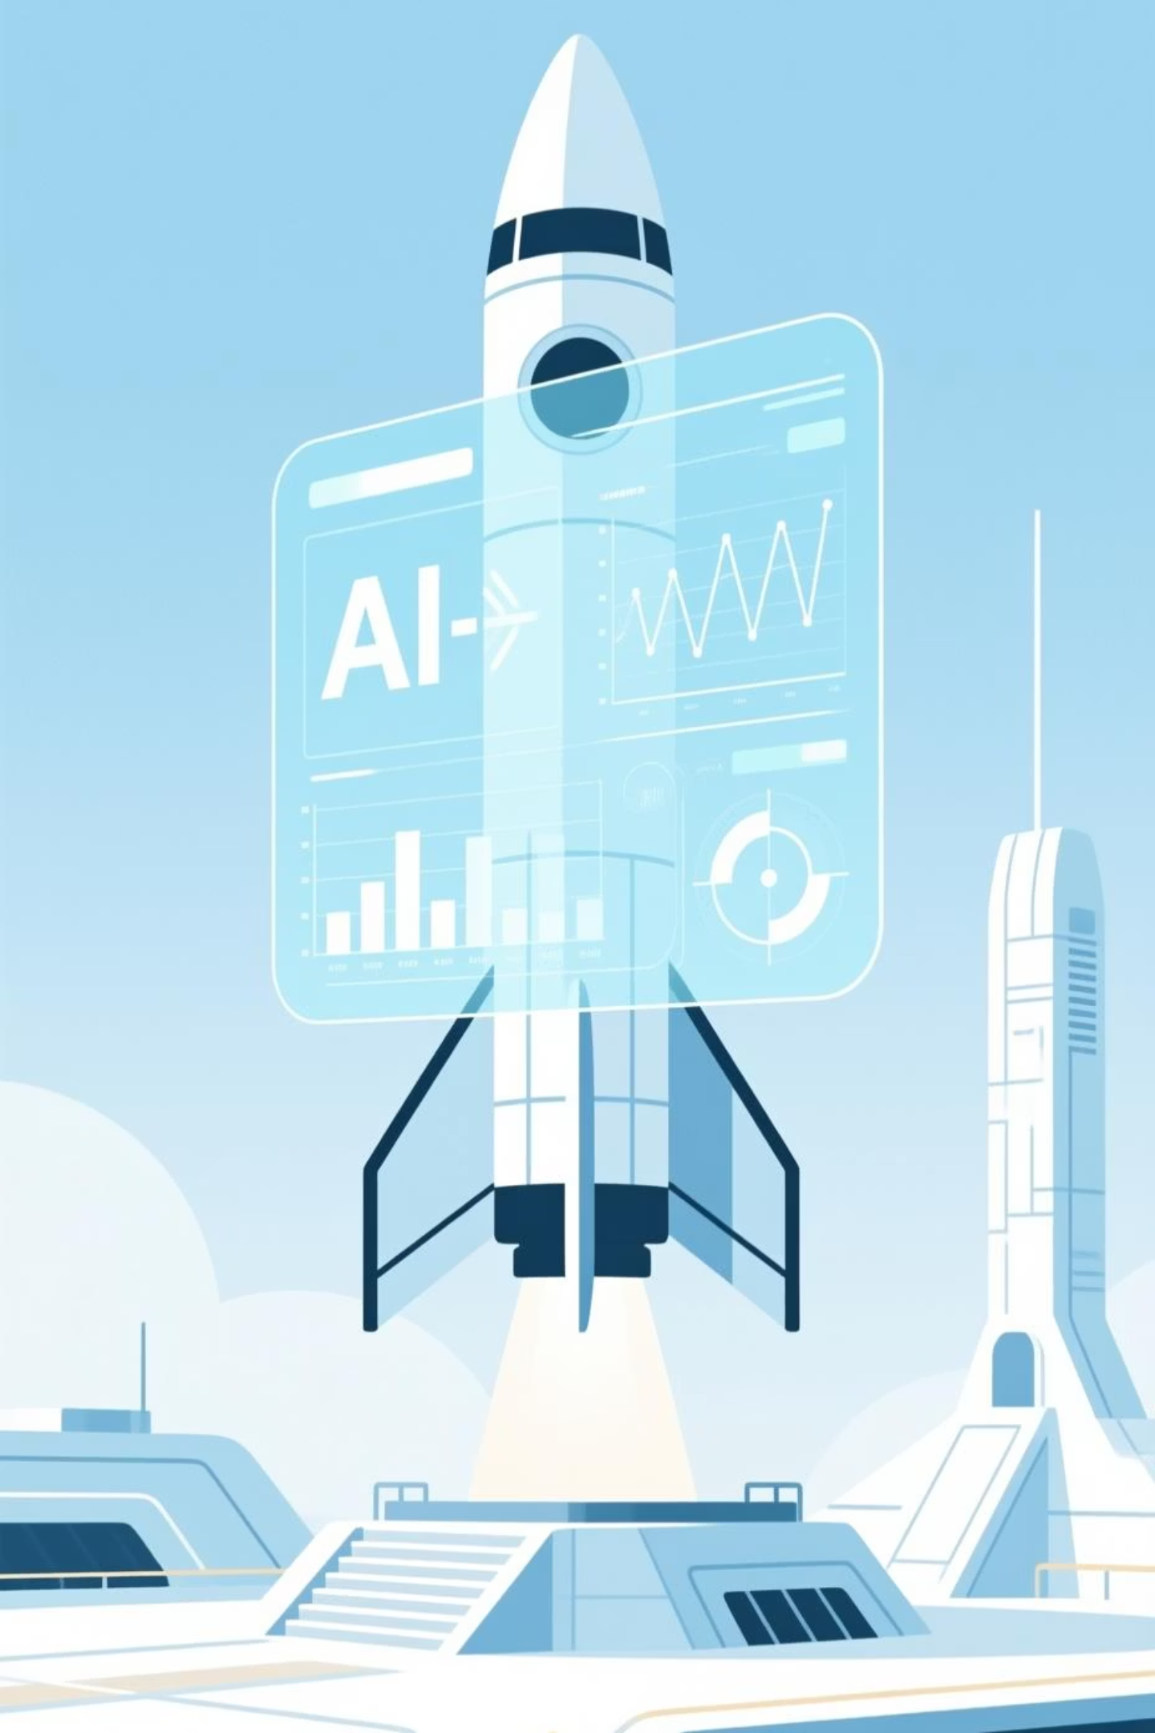
Phase 1
The Launch Phase
Ensuring mission success from the very beginning with predictive AI for robust spacecraft health.

Slide 3



Health Monitoring
Anomaly Detection
Failure Prediction
Real-time AI analysis of telemetry data, predicting component fatigue and life cycles for all critical systems.
Machine learning algorithms identify subtle deviations from normal operating parameters, preventing minor issues from escalating.
Deep learning models forecast potential system failures with high accuracy, enabling proactive maintenance and mission adjustments.
Our AI continuously learns from vast datasets of past missions and simulations, offering unprecedented levels of reliability for complex spacecraft.

Slide 4

Phase 2
The Orbit Phase
Navigating the unforgiving vacuum of space with intelligent autonomy and optimized resource management.

Slide 5
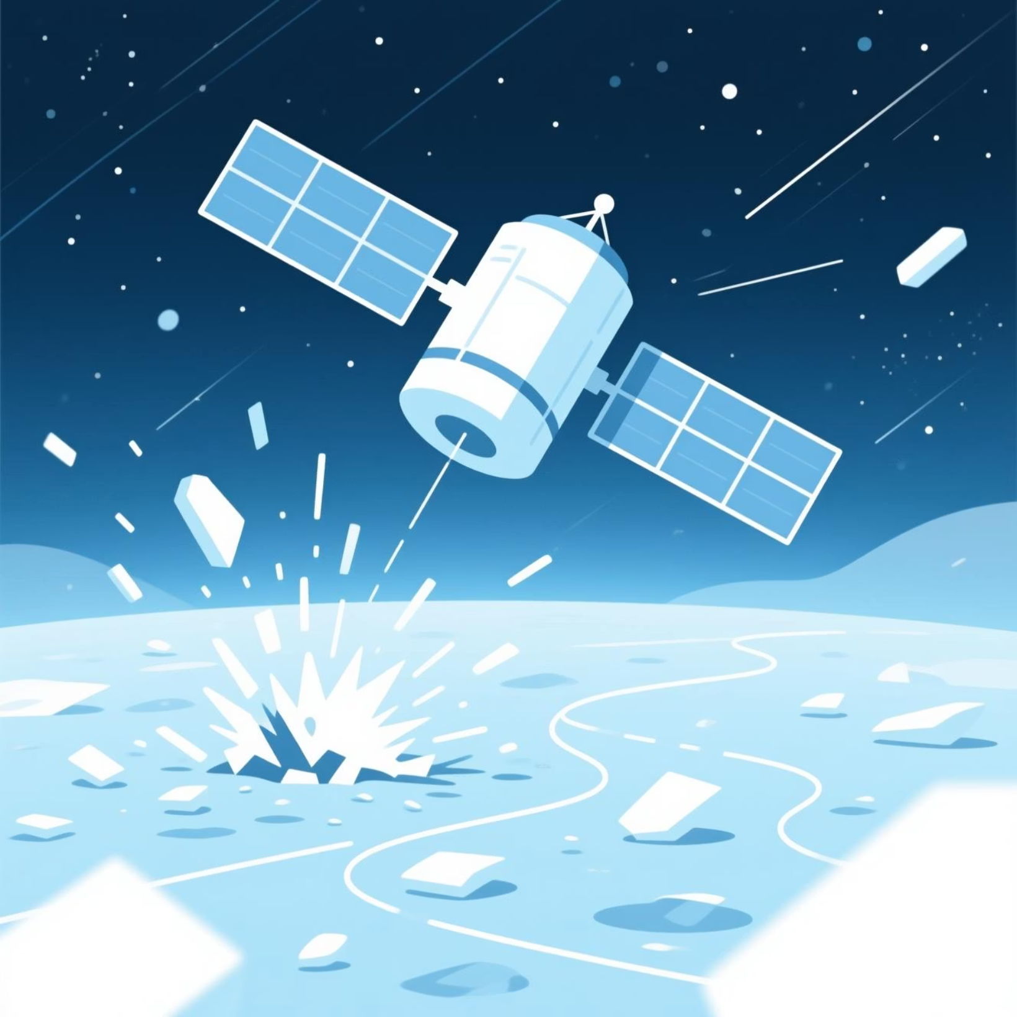
Space Debris Avoidance
Our AI uses predictive modeling to map debris fields and dynamically plot collision-free trajectories, safeguarding valuable assets.
This dynamic recalculation happens in milliseconds, far surpassing human reaction times, ensuring constant mission safety.

Slide 6

Fuel Optimization
Reinforcement learning algorithms constantly refine propulsion maneuvers, achieving maximal fuel efficiency for extended mission durations.
This capability translates directly into lower mission costs and the ability to reach more distant targets with existing fuel reserves.
Simulated fuel consumption with AI optimization.

Slide 7
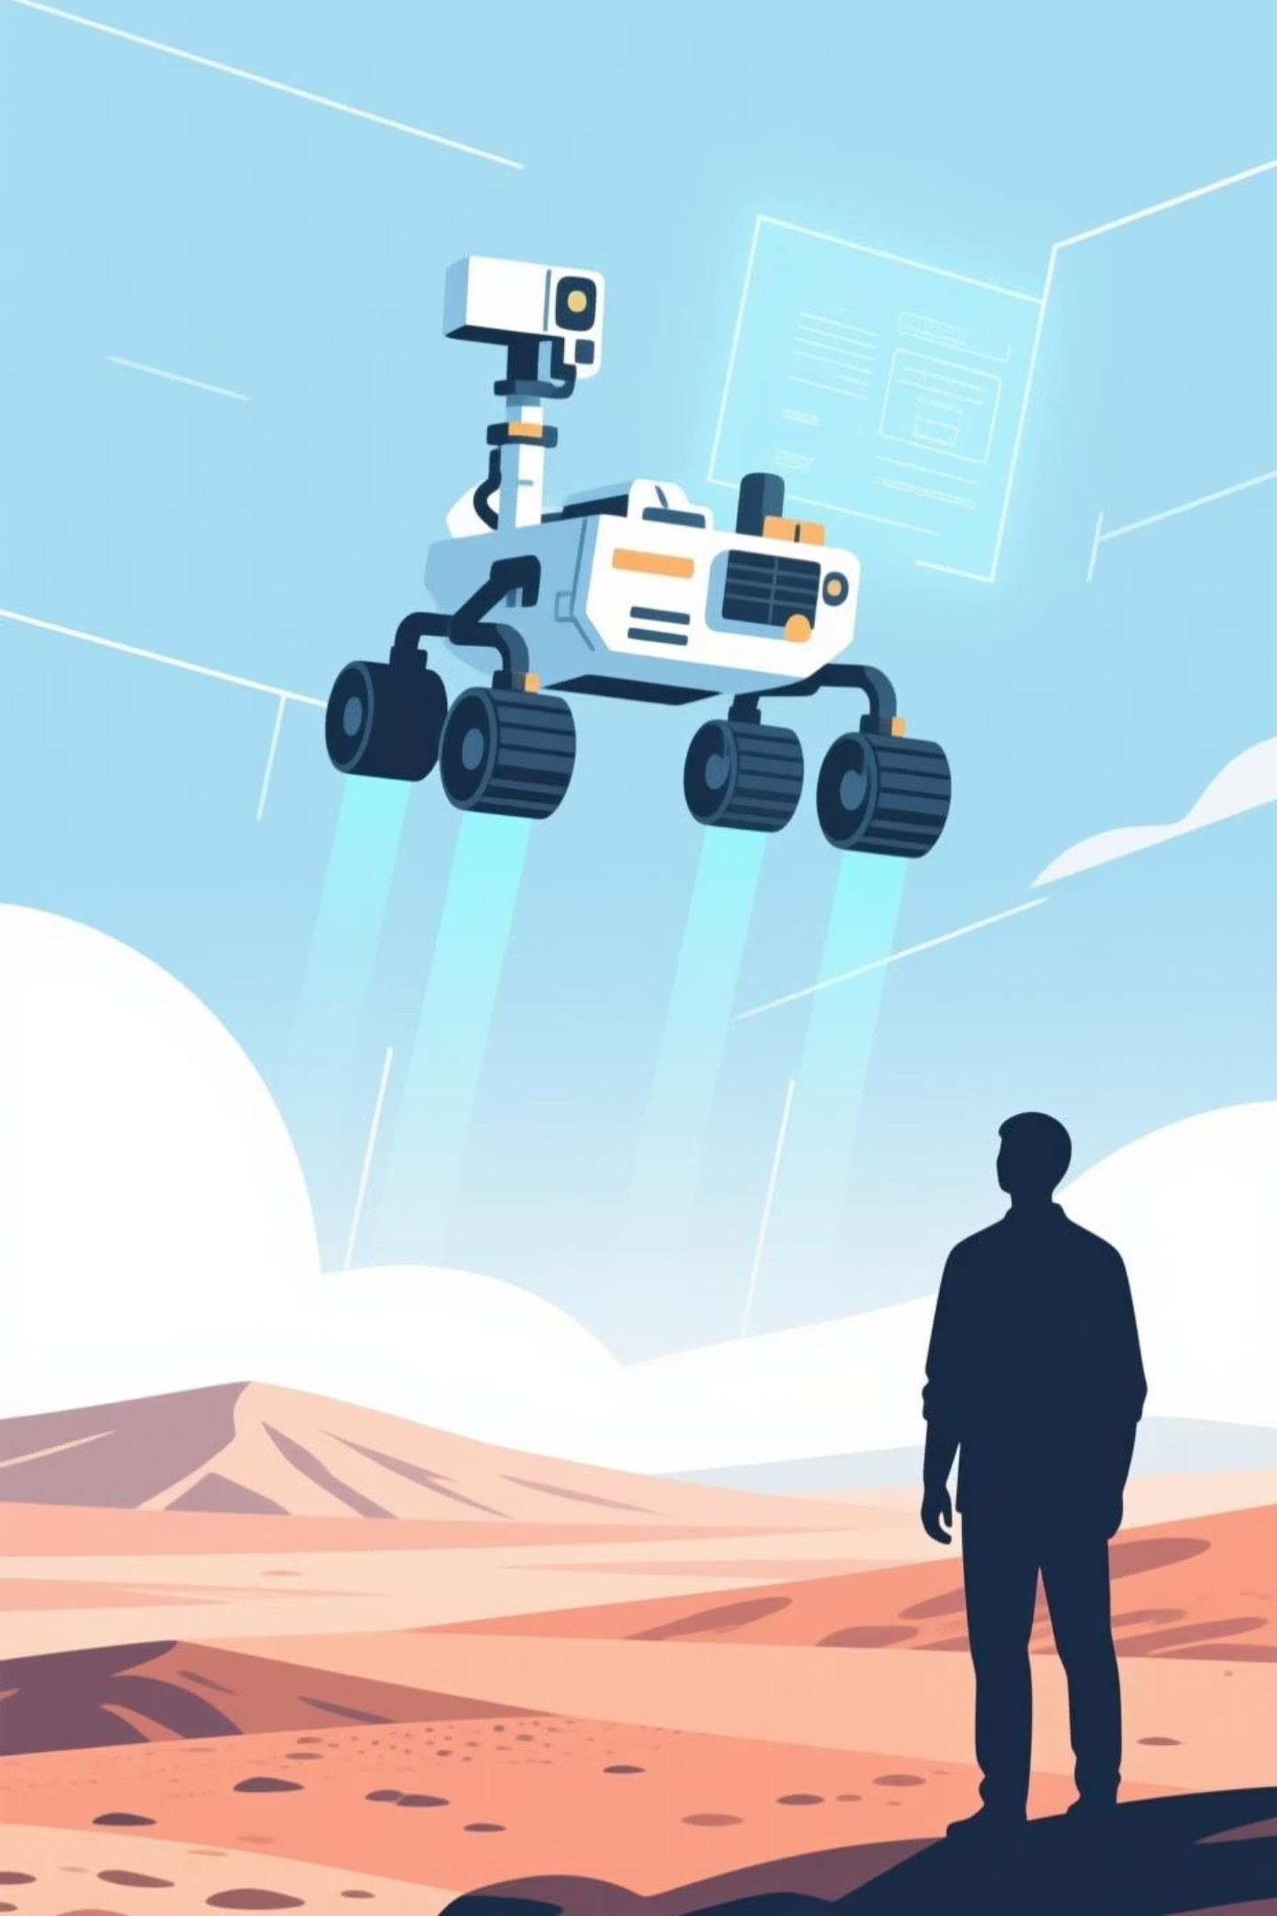
Phase 3
The Landing Phase
Precision landings and autonomous exploration, bringing the wonders of distant worlds within our grasp.

Slide 8


Autonomous Navigation
Automated Descent
Post-landing, AI pilots the rover, identifying hazards and optimizing exploration routes across challenging alien landscapes.
AI agents analyze terrain and atmospheric conditions in real-time to execute flawless, pinpoint landings.
Human Override
Onboard Science
Crucially, human operators on Earth retain full manual override capabilities for critical decisions or unforeseen circumstances, ensuring safety and control.
The AI directs scientific instruments, intelligently selecting targets for data collection and analysis.

Slide 9
Key Takeaways
Enhanced Safety & Reliability: AI-powered health monitoring and anomaly detection significantly reduce mission risks.
Optimized Performance: Intelligent navigation and fuel efficiency extend mission capabilities and reduce operational costs.
Autonomous Exploration: AI-driven rovers can perform complex tasks on their own, accelerating scientific discovery.
Human-AI Collaboration: Our system ensures AI augments human capabilities, not replaces them, maintaining critical oversight.
“Our AI-powered simulation is not just a tool; it's a launchpad for future discoveries, making the impossible, inevitable.”

